Slide 1
Security Assessment and Testing
Sonika Verma
CSCD92: Week 09

Slide 2
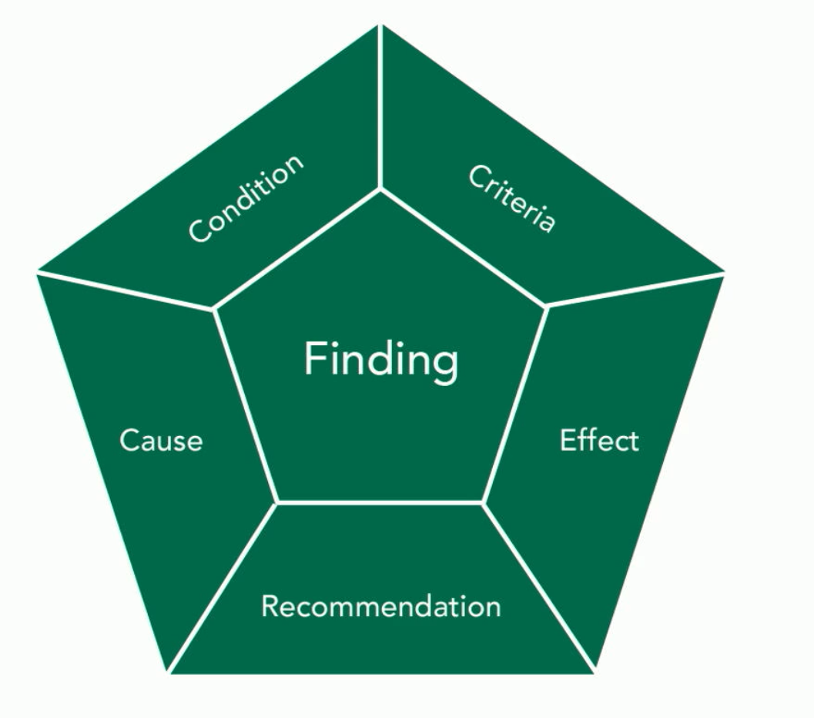
Design and Validate Assessment, Test, Audit Strategies
Auditing
Artifacts
Findings
Assessments
Examination
Compliance calendar

Slide 3
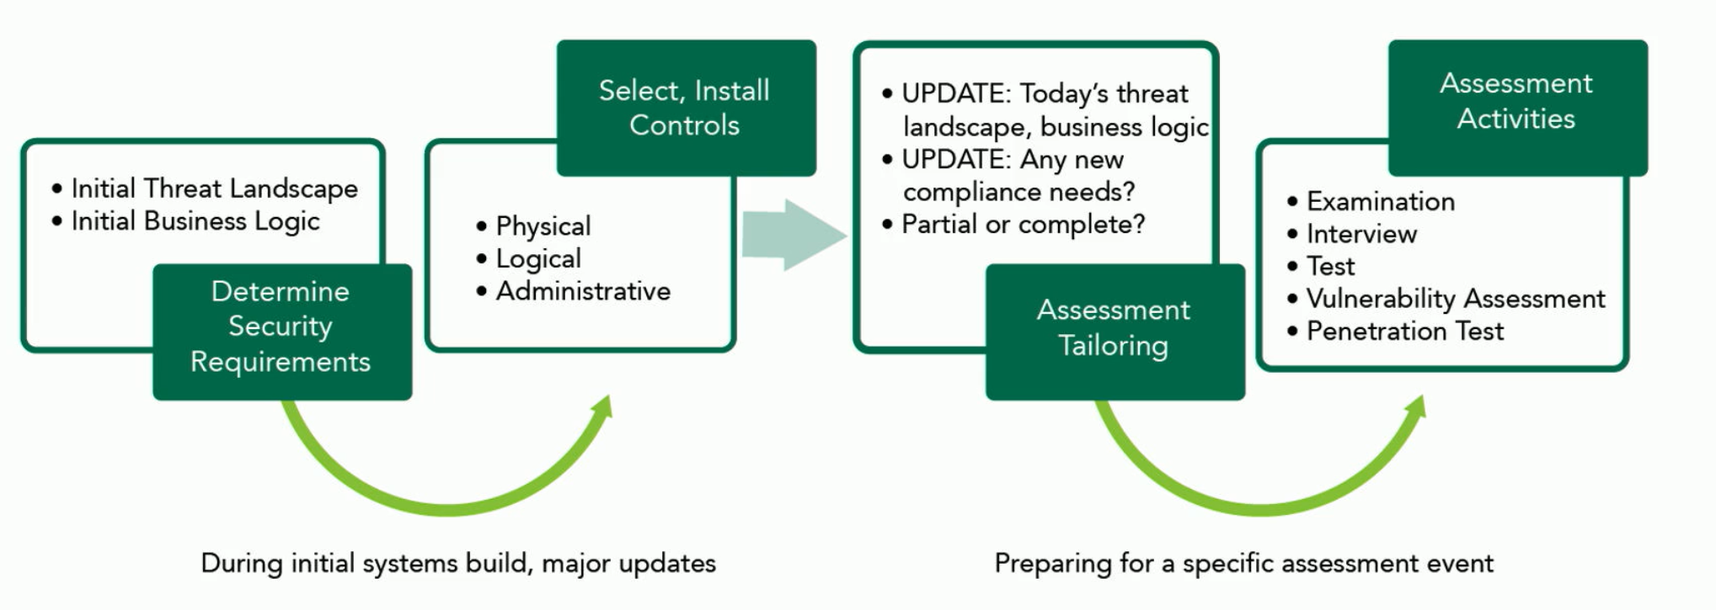
Security Assessments & Frameworks
NIST
ISO
SOC Reports
SOC1, SOC2, SOC3
Type I, Type II
Trust Service Criteria
Internal, external assessment processes
Audit types
Managed services

Slide 4
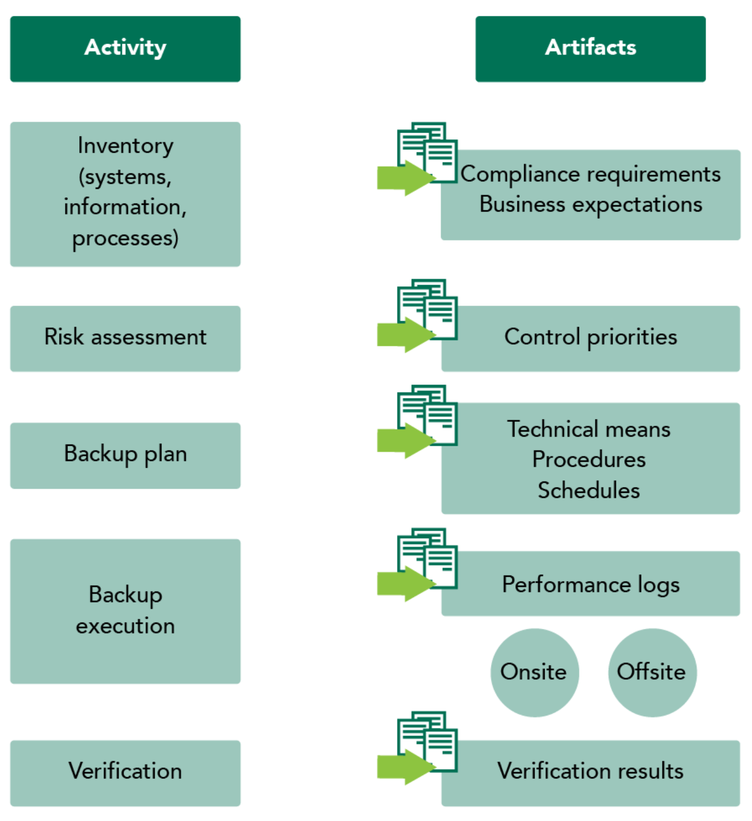
Conduct Security Control Assessments
Security assessment policies
Log management & review
Compliance tests, substantive tests
Statistical sampling
The trusted insider
Code, architecture review
Misuse case testing, negative testing, interface testing
[Ethical] penetration testing
Rules of Engagement
Chaos engineering

Slide 5
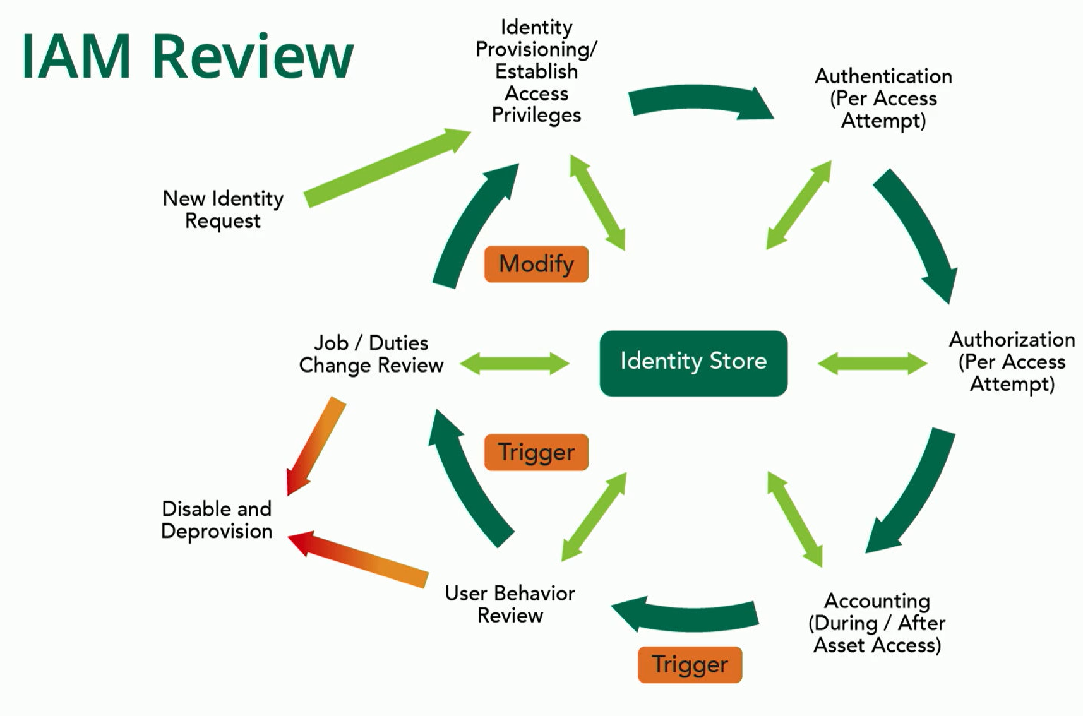
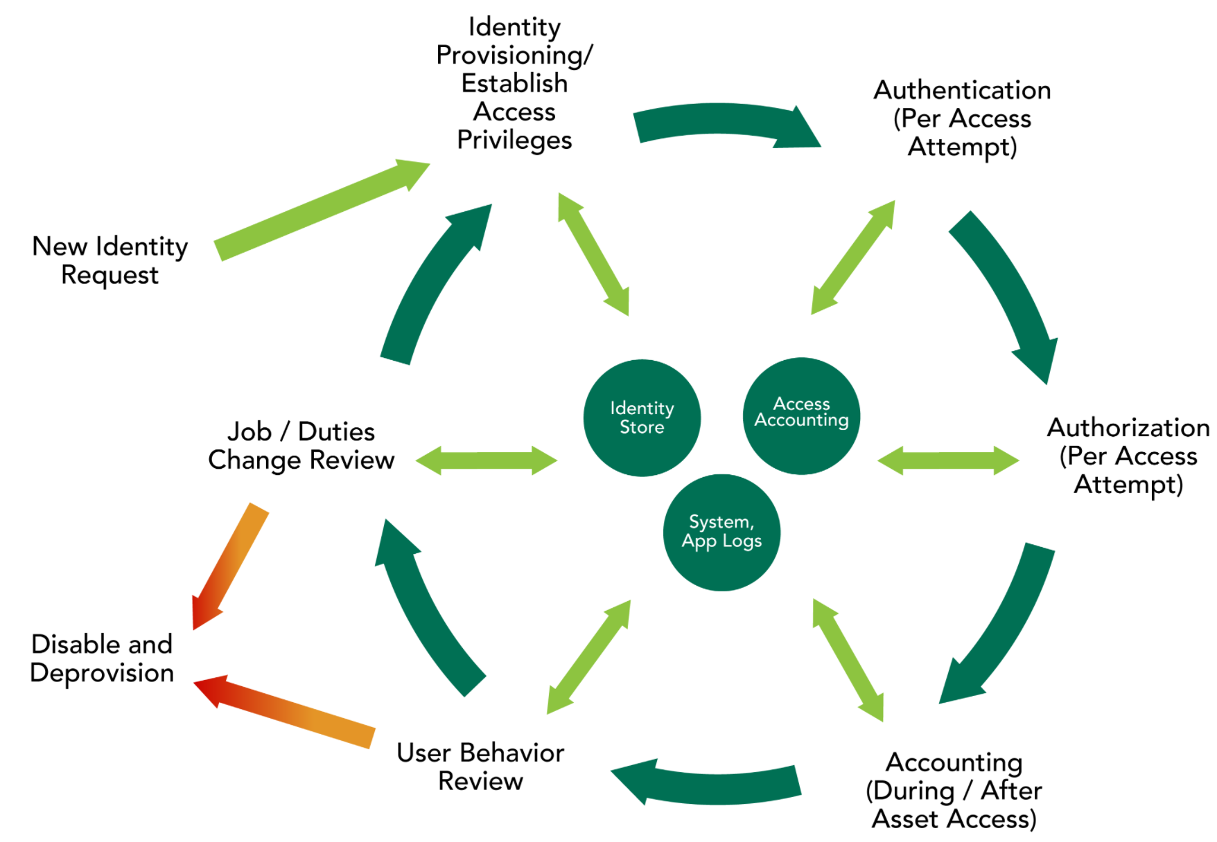
Collect Security Process Data
Account management
Real user monitoring
Synthetic performance monitoring
Periodic management reviews and approvals
Security education, training, and awareness
Disaster recovery and business continuity

Slide 6
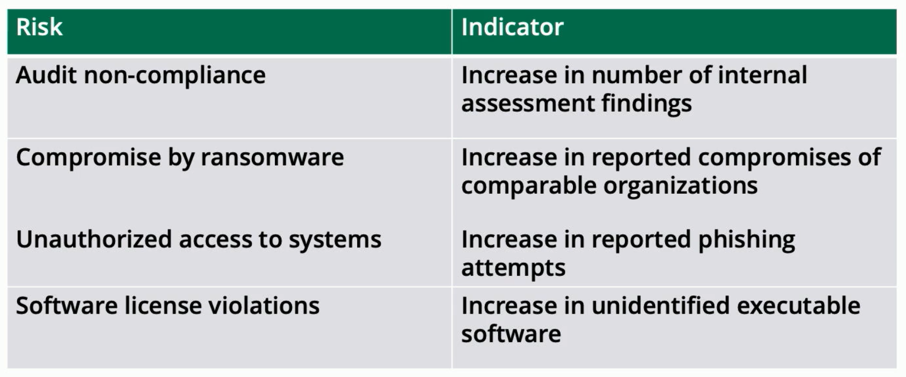
Analyzing and Reporting Organizational Performace
Key performance indicators
Key risk indicators
Remediations
Exception handling
Ethical disclosure
full, non-disclosure, responsible, mandatory reporting, whistleblowing

Slide 7
Security Monitoring Use Cases by Data Sources
Sonika Verma
CSCD92: Week 09

Slide 8
“Top Ten” Security Operation Use Cases
Privileged entity monitoring
Brute force authentication failures
Authentication anomalies
Service accounts, user logon activity profiles, shared account usage
Session anomalies
Timed sessions, profile changes, firewall activity/denies, network communication
Account anomalies
Data exfiltration indicators
HTTP(S) send/receive mismatch, file transfer protocol(s), storge site use, information sharing interfaces
Signature matches to known vulnerability scan results
(excessive) service failure(s)
Insider threats
Accessing secure data/processes, external hard drives, authentication baseline violations, authentication failures
Security log data failure conditions

Slide 9
Common Data Sources
AntiSpam and Email messaging
Attachments, email bursts, infected mails, spam, non-authorized systems, auto forwarding, constant email transmission
[Web] Phishing Scams, Doppelganger Domains
Antivirus systems
Virus detection, potentially unwanted programs, password dumpers, status/update/failure conditions, infections
Application whitelisting
Unauthorized installations, unauthorized drivers, first observed binary (adverse conditions)
Command and Control
Data Loss Prevention
Domain Name Servers
End Point Detection and Response
Account Usage Events

